Slide 1


Slide 2
Project Chao
/ˈkeɪɒ/
Meaning is better when shared
NAM Nguyen

Slide 3

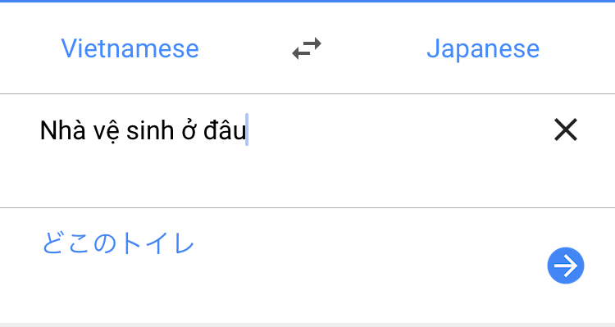
Why Chao?
Why traditional solutions don’t work so well?
LANGUAGE is every where
So is TRANSLATION
LANGUAGE evolves
DICTIONARY is obsolete → CLOUD
MEANING MATTERS!!

Slide 4
How Chao?
How Chao solves the problem?
If you are serious about Meaning, you fix it.
Interact with MEANING, easily and happily
Sharing / evaluating / improving
The local knows better than the Cloud

Slide 5
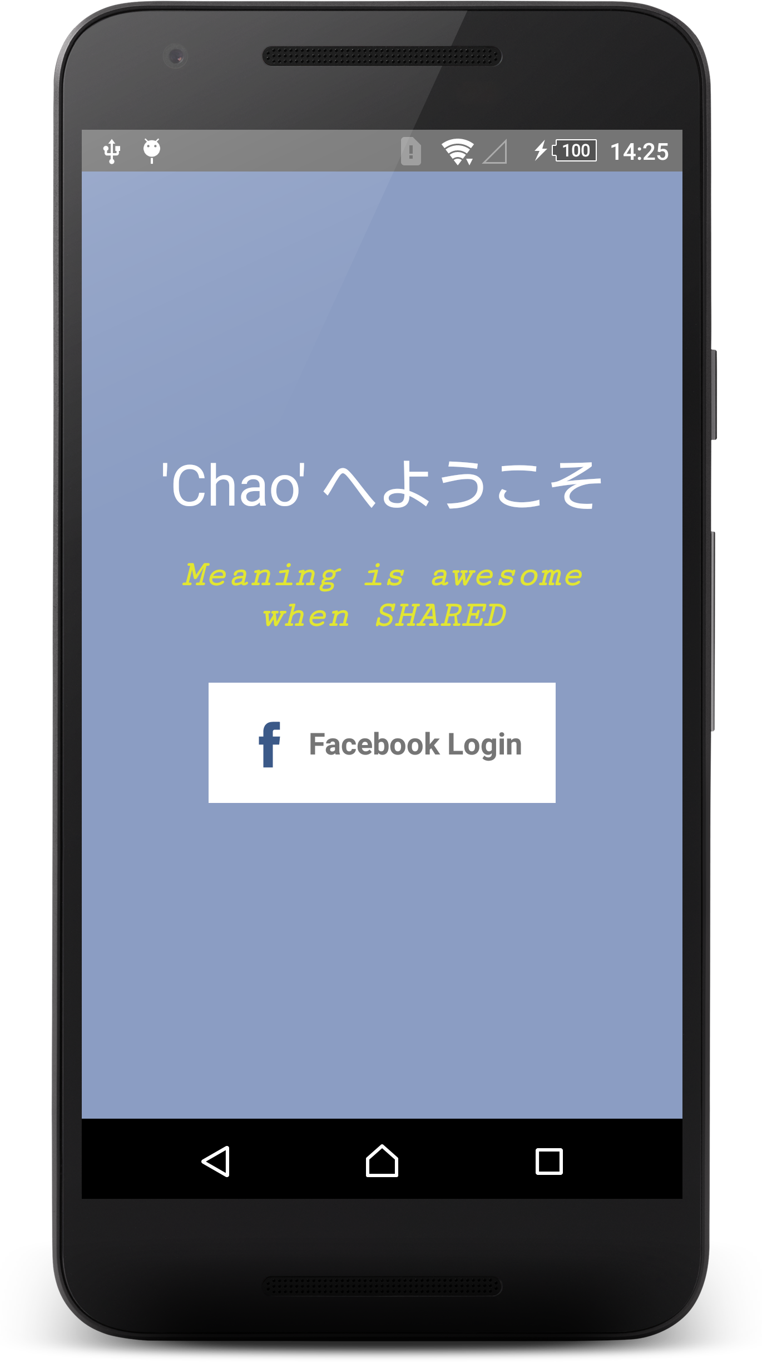
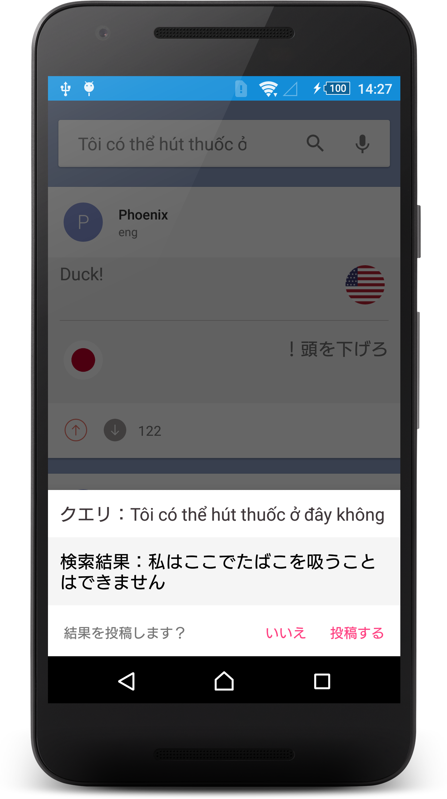
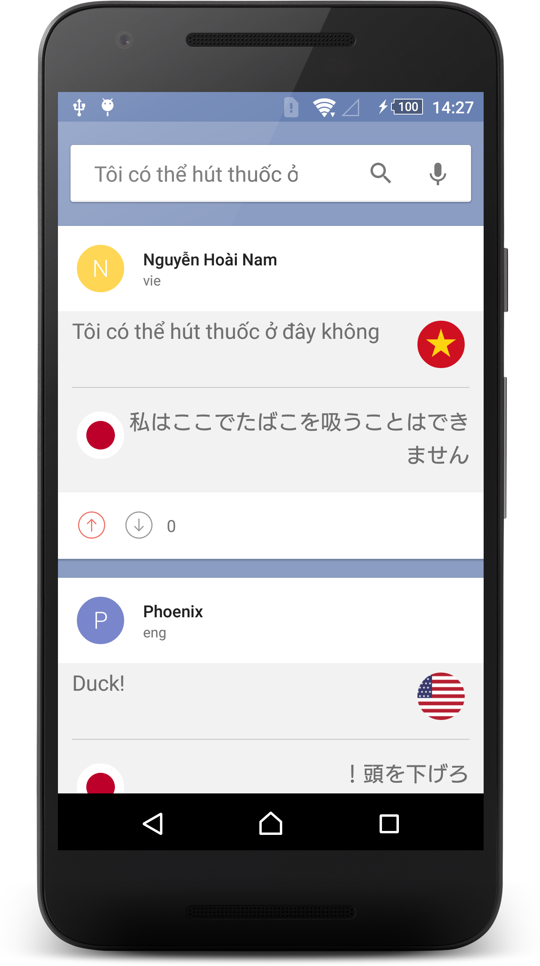
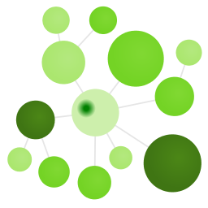


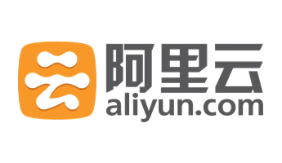
What Chao?
What Chao be?

Slide 6
Chao&2020,人,言語?
Who will use Chao?
Those who want to know the Meaning
Including tourisms, language leaners…
Those who want to improve the Meaning
Including researchers, local people
Those who want to share the Meaning
Maybe including you
Those who want to touch the Meaning
Me, of course

Slide 7
Chao&Future
Is Chao good? – NOT YET
Feature: Bookmark, default sentences
Feature: Share by QR Code to ask for more
Improvement: UI/UX
Performance: Cloud and Ground
After Hackathon?
I keep working on it
You are welcome to contribute
Source, license?
GNU 3.0 to keep things good
Github ready: https://github.com/eneim/Project-Chao

